Slide 1
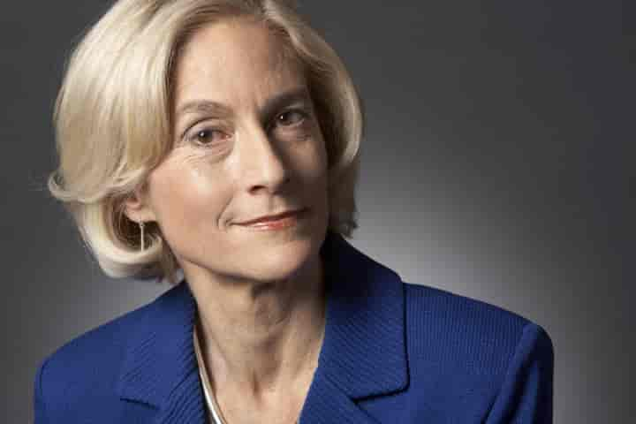
Capability Approach to Social Justice Gender Inequalities in Canada
Jay Lee, Simranpreet Kaur, Elizabeth Graham, Anoop Kaur, Haritika Sharan, Anmolpreet Kaur
GROUP 6
PHIL 1100 - 002

Slide 2
“I propose that we should focus on the question of what a person is actually able to do and be, in terms of real opportunities available to her, and of the real capabilities that she actually possesses”
- Martha Nussbaum

Slide 3
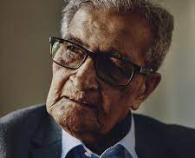
About Capability Approach
- What is Capability Approach?
- Emphasis on Individual Agency
- Diverse and Context-Specific
- Taking Social and Structural Factors
- Assessing Social Policies

Slide 4
What is the Capability Approach?
- The foundation for the capacity approach to social justice was created by economist and philosopher Amartya Sen, and it was expanded upon by philosopher Martha Nussbaum.
- The approach focuses on the idea that the well-being of individuals should be assessed based on their capabilities, or the real opportunities they must lead a flourishing life.

Slide 5
More About Capability Approach
- Stated differently, it highlights not just the things or resources that individuals possess, but also their capacity to make use of those resources to lead a life that they should value.
- In addition to Sen's capacities framework, Nussbaum has put out a list of fundamental human capabilities that, in her opinion, are necessary for a life marked by dignity and prosperity. Some of the skills she lists are maintaining physical well-being, having relationships and emotional attachments, reflecting critically, and taking part in political and economic activities.

Slide 6
Emphasis on Individual Agency
- The capability approach strongly emphasizes each person's capacity for self-determination and pursuit of their own objectives.
- This makes it possible to comprehend individual well-being in a more complex way since it considers people's capacity to utilize their resources to influence their own lives in addition to their actual resources.

Slide 7
Diverse and Context-Specific
- The method acknowledges the diversity of human lives as well as the possibility that people may value different skills according to their social, cultural, and personal contexts.
- As a result, it becomes a more inclusive framework that takes into consideration the many needs and goals that individuals may have.

Slide 8
Taking Social and Structural Factors into Account
- The capacity approach considers how political, social, and economic factors affect people's capacities.
- In doing so, it offers a means of examining and denouncing structural inequalities that could limit people's prospects and capacities.

Slide 9
Assessing Social Policies
- According to Nussbaum, the capabilities perspective offers a useful instrument for assessing institutions and social policies.
- Evaluating the extent to which these policies advance social fairness and human capacity is helpful

Slide 10
More On Assessing Social Policies
- The capacity approach, in Nussbaum's opinion, provides a thorough and adaptable framework for comprehending and analysing social injustice
- The capacity approach offers a deep and dynamic view of well-being and social justice by emphasizing what people are truly capable of doing and becoming, as opposed to merely what they have.

Slide 11

Gender Inequality & Gender Pay Gap
- Political Participation
- Education
- Economic Participation
- Safety & Security as Capabilities
- Approaches to Eliminate Gender Pay Gap
- Policy Implications

Slide 12
Political Participation
- Nussbaum highlights the value of political engagement as a skill.
- Ex. Because there aren't enough women holding political office, they can't participate fully in the political process, which can lead to a lack of different viewpoints and possibly insufficient representation of women's interests.

Slide 13
Education
- One of the fundamental skills in Nussbaum's approach is education
- Disparities in access to and educational opportunities may be at the basis of gender inequity in leadership roles
- Women who lack access to high-quality education may find it more difficult to achieve leadership positions

Slide 14
Economic Participation
- Leadership positions often come with financial advantages and prospects
- Women's capacity to participate in the economy and achieve financial independence is restricted by gender disparity in leadership roles
- Leads to the gender pay gap overall.

Slide 15
Safety & Security as Capabilities
- According to Nussbaum, security and safety are fundamental qualities
- Women may experience harassment, discrimination, or other safety issues in public and professional settings due in part to gender inequity.

Slide 16
Approaches to Eliminate Gender Pay Gap
- Raising awareness of Inequalities. As it acts as a starting point for understanding the extent of the issue, which ranges from unequal compensation to neglected representation in leadership.
- It is essential to acknowledge this to spread awareness and inspire change-related actions.

Slide 17
Policy Implications
- With knowledge of gender inequality, policymakers can try to put into effect laws that deal with the root causes
- This could involve taking steps to support gender-sensitive education, diversity in leadership roles, and pay equity.

Slide 18

Why Capability Approach?
- Insight on the benefits of capability approach
- Measure that are used to rectify gender inequality
- How well does the benefits apply on gender inequality

Slide 19
Benefits of the Capability Approach
- Martha Nussbaum’s capability approach derives from her believing in people’s well-being and having the capability to function in key areas listed in previous slides.
- Lack of well-being would indicate conditions of oppression. Her measures of well-being can be used to avoid oppression
- By setting our goal to align with Nussbaum’s capability approach, we can prevent one gender from being oppressed and other from over-empowerment

Slide 20
How is this beneficial to Gender equality?
Since our priority is to avoid oppression, it is easier to:
- Address central capabilities
- Develop and implement gender responsive polices
- Measuring progress

Slide 21

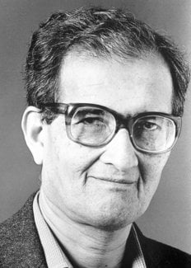
Elements Not Adequately Represented By The Capability Approach

Slide 22
Concerns on the Approach
- Amartya Sen and Martha Nussbaum established the capacity approach, which is a paradigm for assessing social justice and well-being based on people's freedoms and capacities to lead meaningful lives.
- Although the capacity method is a thorough and useful technique for identifying and resolving different types of injustice, it has several drawbacks.

Slide 23
Subjectivity and Differences in Culture
- The capacity approach is predicated on a set of talents that are universally valued, however what people or communities regard as necessary skills may differ depending on their culture.
- The method might not adequately take into consideration the many cultural viewpoints on justice and well-being.

Slide 24
Both Personal Responsibility and Agency
- The capacity approach has its detractors who claim that it overemphasizes human skills while undervaluing the importance of personal agency and accountability.
- Individuals' decisions and behaviours may give birth to certain types of injustice, and the method might not adequately capture the subtle differences between capabilities limited by human choices and those restricted by outside forces.

Slide 25
Equitable Distribution
- The capacity approach highlights the value of developing people's capacities, but it does not specifically address questions of distributional justice, especially when it comes to the unequal distribution of opportunities and resources.
- Opponents contend that the strategy might not offer precise instructions on how resources ought to be allocated in order to guarantee a more equitable society.

Slide 26
The Adaptive Character of Welfare
- The capacity approach offers a fixed perspective on well-being at a certain moment in time.
- It can fall short of capturing the dynamic aspect of well-being, which is subject to change throughout life or in reaction to experiences.
- The approach's capacity to address temporal dimensions of injustice may be impacted by this constraint

Slide 27
Political and Financial Systems
- The capacity approach places a strong emphasis on individual liberties but might not go in-depth on the structural elements that might lead to injustice, such as the political and economic structures.
- It could be necessary to use additional frameworks or methodologies in addition to the capabilities approach to address these more general systemic problems.

Slide 28
Challenges in Measuring
- Accurate capacity measurement is fraught with difficulties.
- Capabilities can be hard to quantify and compare amongst people or groups.
- The creation of policies and their actual execution may be hampered by this.

Slide 29

Utilizing Capability Approach for Addressing Gender Inequality
- The capability approach is a great way to evaluate gender inequality not only in Canada but around the world.
- If Canada used the capabilities approach to assess what gender related issues need resolving, gender inequality can be positively affected in multiple aspects of life.

Slide 30
Capability Approach on Gender Inequality
The approach assesses injustice based on how one’s basic human capabilities are affected
Gender is a vital role in one’s life and unique to the individual
Approaching social injustice from multiple perspectives with an interdisciplinary lens is easier and concise when using the capabilities approach
Can help in creating multiple solutions to different sides of an issue
The ten capabilities are similar to human rights
This connects to gender inequality and the nominal rights granted to those oppressed within society
When using this approach, one can recognize and investigate injustice fairly

Slide 31

Q & A

Slide 32
Citations & References
Images: All images CC (Creative Commons) Martha Nussbaum – https://snl.no/Martha_Nussbaum https://commons.wikimedia.org/wiki/File:Martha_Nussbaum_2010.jpg Amartya Sen – https://www.newyorker.com/news/the-new-yorker-interview/amartya-sens-hopes-and-fears-for-indian-democracy https://www.nobelprize.org/prizes/economic-sciences/1998/sen/biographical/ slides – https://www.ucl.ac.uk/bartlett/development/events/2022/oct/book-launch-cities-human-development-capability-approach-city-making Sources: Nussbaum – Women and Cultural Universals PHILL 1100 course lecture slides

